Slide 1
YOUTUBE CHANNEL GROWTH ANALYSIS
presented by
ISWARYALAKSHMI M

Slide 2
Introduction
In today’s digital era, YouTube is one of the world’s largest online video-sharing platforms, with millions of creators and billions of users globally.
Every day, creators generate massive amounts of data such as views, likes, comments, subscribers, and watch time. This data plays a crucial role in understanding how content performs and how audiences interact with videos.
However, analyzing such large volumes of data manually can be difficult and time-consuming.
Therefore, this project focuses on building an interactive Power BI dashboard to analyze YouTube channel performance. By using data visualization techniques, we can better understand audience engagement, content effectiveness, and overall channel growth trends.

Slide 3
Problem statement
In today’s digital era, YouTube generates a massive amount of data every second, including views, likes, dislikes, comments, subscribers, and watch time. However, manually analyzing this large volume of data is difficult, time-consuming, and inefficient.
Without proper data visualization tools, it becomes challenging to track channel growth over time, measure audience engagement, compare video performance, identify trends and patterns, and make data-driven content decisions.
As a result, content creators and analysts may struggle to understand which videos perform well and how to improve their overall channel strategy.
This project aims to solve this problem by developing an interactive dashboard using Power BI that transforms raw YouTube data into meaningful visual insights for effective analysis and decision-making.

Slide 4
Business Problem
What is the monthly trend of total YouTube views?
Identify the top-performing channels based on cumulative view count?
How are total likes distributed across different months?
What are the top 5 channels based on total views?
Which channels have the highest and lowest total likes, and what is their approximate count?
What is the approximate number of comments for the most active channel?
Which channel has the highest total comments?

Slide 5
Data overview
Channel Id
Channel Title
Comment Count
Comments
Day
Description
Dislikes
Hour
Likes
Video Id

Slide 6
Technology used
Data Source:
Youtube Dislike Dataset (Excel file)
Data Preparation & Transformation (ETL):
Power Query: To clean, transform, and structure data
Data Modeling: Creating tables Date table, Likes and Dislike, Video ID, and Youtube table linking relationship.
Data Analysis & Visualization:
Power BI :
Charts: Area chart, Bar chart, Column chart, Pie chart, Donut chart.
Measures using DAX.
Data Insights & Reporting:
Power BI Dashboard: Interactive visualizations for executives
Filters & Slicers: To analyze performance trends over time and compare growth across different months and years

Slide 7
Data Preprocessing
The Best Tool For Cleaning And Preprocessing The Data Is Called As Power Query Editor.
It Is Used For Extracting The Data, Transforming The Data And Loading Into Power Bi.
Data Cleaning steps :
1.Assign Date type for date columns.
Set Whole Number type for likes and dislikes
Use Text type for channel title columns.
2. Ensures accurate calculations and proper analysis..
3. Append the two year(2020,2021) data into one using append queries.
4. Extract month, month name, hour, day and year from Date Table.
5. Managing empty data by replacing, filling, or removing it to maintain accuracy.
6. Removing the duplicate values.

Slide 8

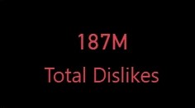
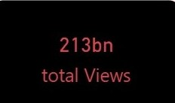

Key Metrics and kPI’ s
These KPIs give a quick snapshot of business performance
Total Likes: It refers to the total number of positive reactions received across all videos, indicating audience engagement and content effectiveness.
Total Dislikes: It refers to the total number of negative reactions received across all videos in the dataset.
Total Views: It refers to the total number of times all videos have been watched in the dataset.
Total Channels: It refers to the total number of different YouTube channels in the dataset.

Slide 9
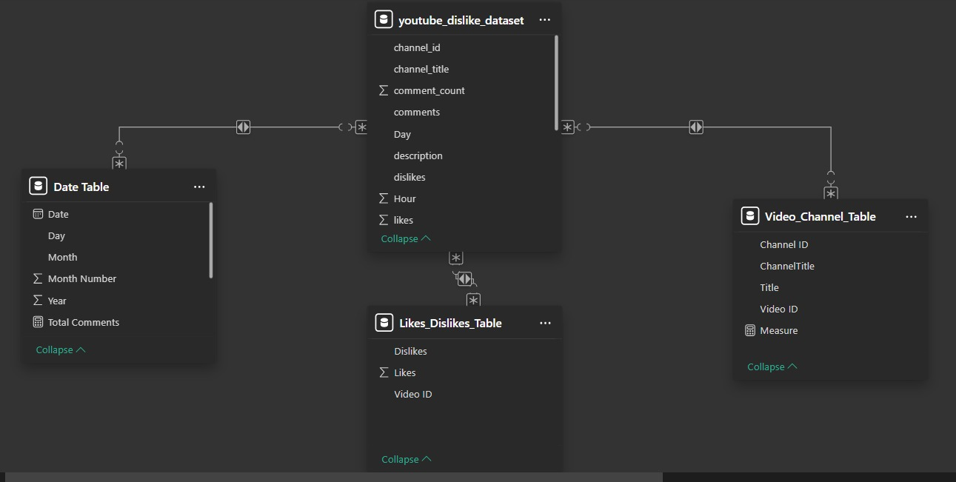
Data Modelling - Overview

Slide 10
Dax Measures
Dax is called as Data Analysis Expression.
DAX is a formula language used in Power BI.
To perform calculations and data analysis.
Measures:
Total Likes = SUM(‘youtube_dislike_dataset'[Total_likes])
Total Dislikes = SUM(‘youtube_dislike_dataset'[Total_dislikes])
Total Videos = DISTINCTCOUNT(‘youtube_dislike_dataset‘[video_id])
Total Comments = SUM(‘youtube_dislike_dataset’[comment_count])
Total View = SUM(‘youtube_dislike_dataset’[view_count])
Total Channels = DISTINCTCOUNT(‘youtude_dislike_dataset’[channel_title])

Slide 11
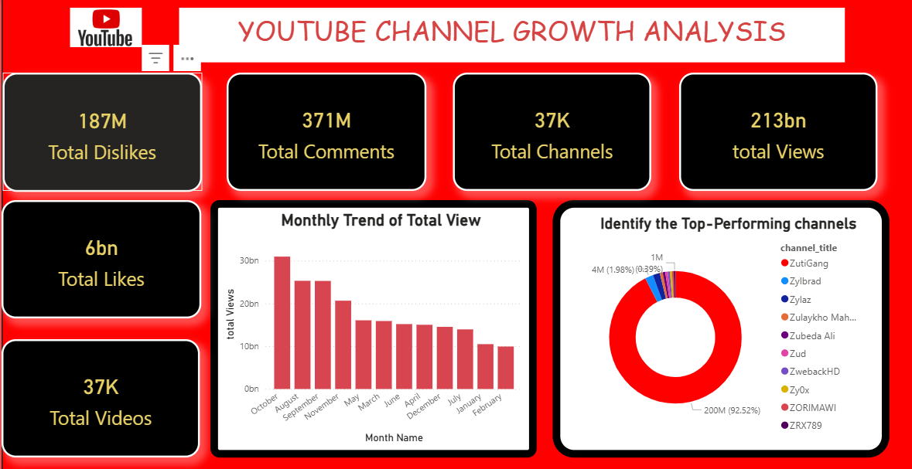
Power BI Dashboard Overview

Slide 12
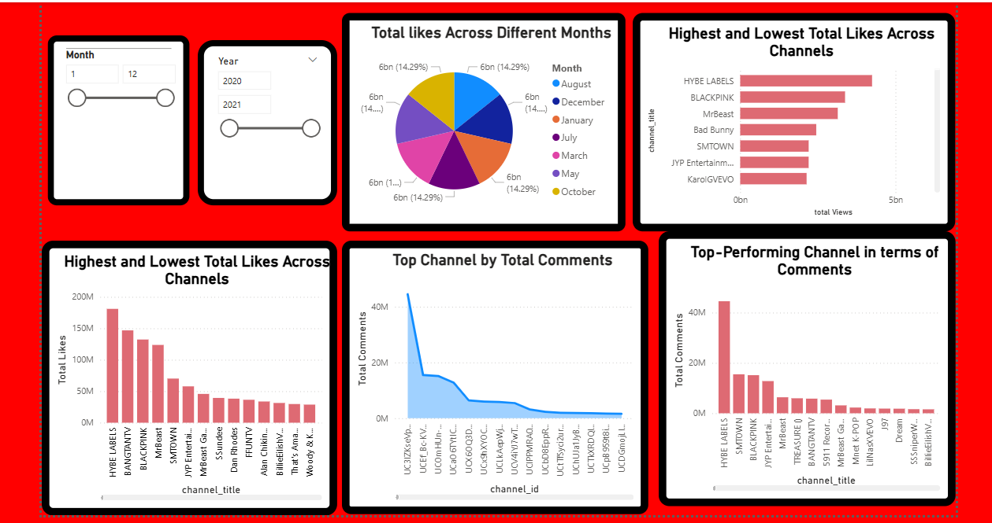

Slide 13
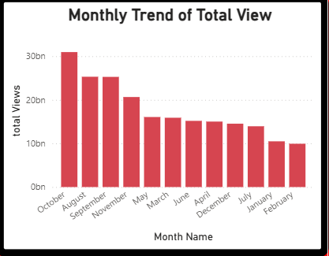
Monthly trend of total views
Stacked column chart→ horizontal bars are easier to read, it gives quick comparison across Months.
Y axis: Month Name
X axis: Total Views

Slide 14
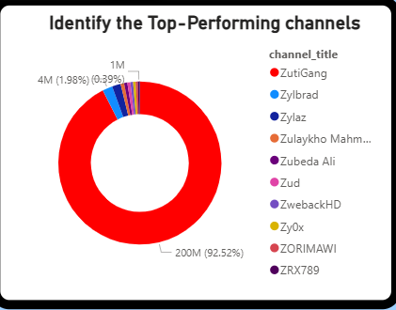
Identify the top-performing channels
Donut chart→ Show each channel’s contribution to total views.
Legend: Channel title
Values: Sum of View count

Slide 15
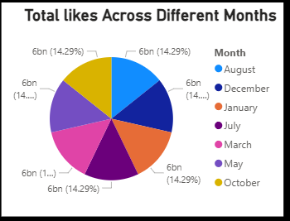
Total likes Across Different Months
Pie chart→ Show each Months received to total
likes.
Legend: Months
Values: Total Likes

Slide 16
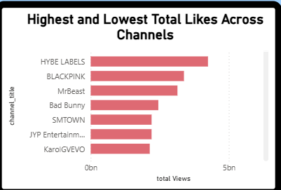
Highest and Lowest Total Likes Across Channels
Stacked column chart→ horizontal bars are easier to read, it gives quick comparison across categories.
Y axis: Channel title
X axis: Total Likes

Slide 17
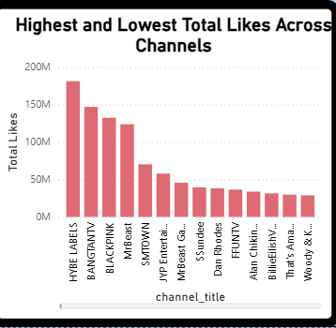
Highest and Lowest Total Like Across Channels
Stacked bar chart→ horizontal bars are easier to read, it gives quick comparison across categories.
Y axis: Channel title
X axis: Total Likes

Slide 18
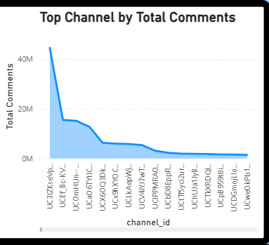
Top Channel by Total Comments
Area chart→ This chart shows how many comments each channel got..
Y axis: Channel id
X axis: Total Comments

Slide 19
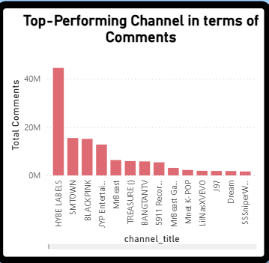
Top-Performing Channel in terms of Comments
Clustered column chart→ horizontal bars are easier to read, it gives quick comparison across categories.
Y axis: Channel title
X axis: Total Comments

Slide 20
Conclusion
The YouTube Growth Analysis dashboard successfully transforms raw YouTube data into meaningful and interactive visual insights. By analyzing key performance indicators such as total views, likes, dislikes, comments, videos, and channels, the dashboard helps track channel growth, measure audience engagement, and compare video performance effectively.
Through proper data visualization techniques, creators and analysts can easily identify trends, understand audience preferences, and make data-driven content decisions. Overall, this project improves strategic planning and supports continuous channel growth in a competitive digital environment.

Slide 21
THANK YOU

